Slide 1
Air Quality – L7
Virendra Sethi
vsethi@iitb.ac.in
7809

Slide 2
Goal of the Air Quality Module
You will be able to explain key concepts of air pollution and air quality management

Slide 3
Air Pollution Control - PM
MECHANICAL
Gravity – Settling Chambers 20 -100 μm
Inertia - Cyclones > 25 μm
Diffusion – Filters > 0.1 μm
ELECTRICAL
Electrostatic Precipitators > 0.1 μm

Slide 4
Control of Gaseous Pollutants

Slide 5
Air Pollution Control - Gases
Absorption
Adsorption
Incineration
Chemical Reactions
Catalysts
Flue gas Desulphurisation

Slide 6
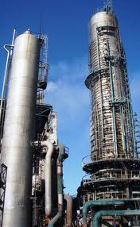
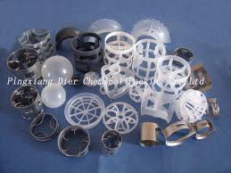

Slide 7
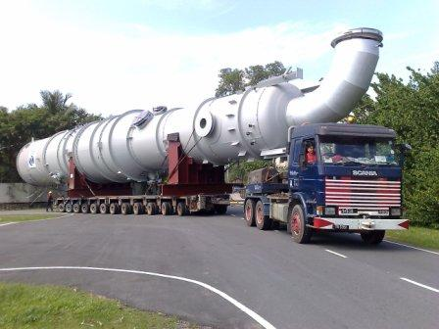

Slide 8
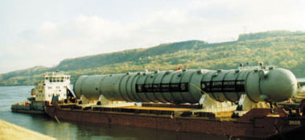

Slide 9


Adsorption

Slide 10
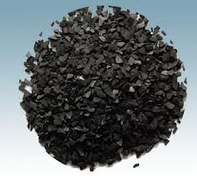
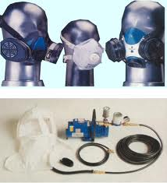

Slide 11
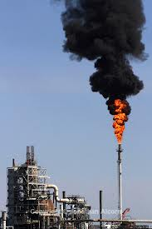
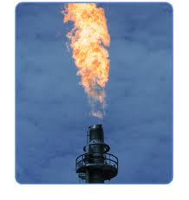
Incinerators - Flares

Slide 12
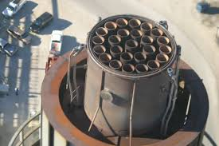

Slide 13
To Learn Today
District Collectors’ perspective

Slide 14
Key Steps in Air Quality Management (AQM)

Slide 15
Meteorological Data
Criteria Pollutant Measurements
Ongoing + Historical data
National Standards (CPCB)
Topography
COMPARE
Inventory of
Sources (Point, Line, Area)
Dispersion Modelling
In Compliance
NOT
in Compliance
Results for Various Scenarios (BAU and Possible Interventions)
Look out to prevent any significant deterioration
☺ For now
COMPARE
* Chemistry used for forensics
Possible Reasons for Differences
Are all sources accounted for ?
Are Industries* in Violation?
Carrying Capacity
Mitigation Measures

Slide 16
Chandrapur A Case Study

Slide 17
Map of Emission Sources and AAQ Monitoring Stations in Chandrapur
17

Slide 18
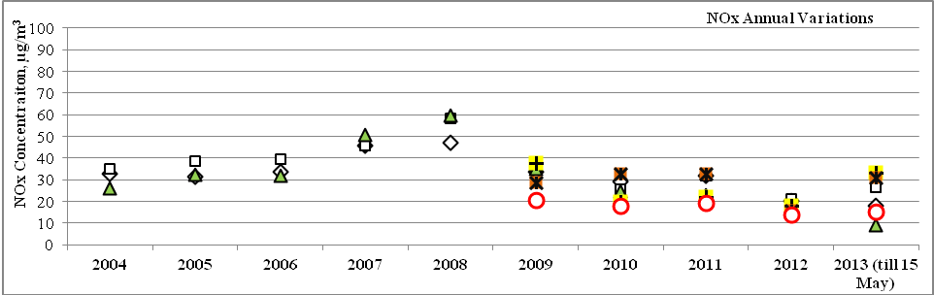
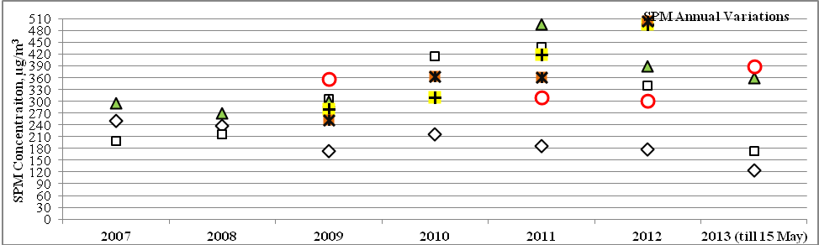
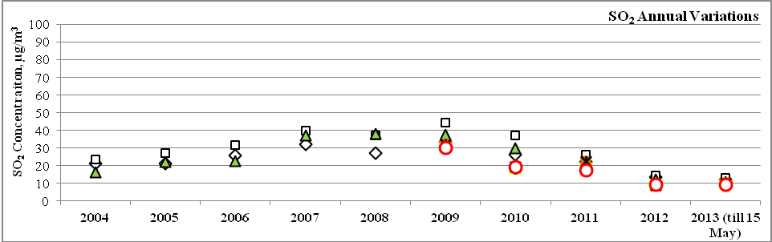
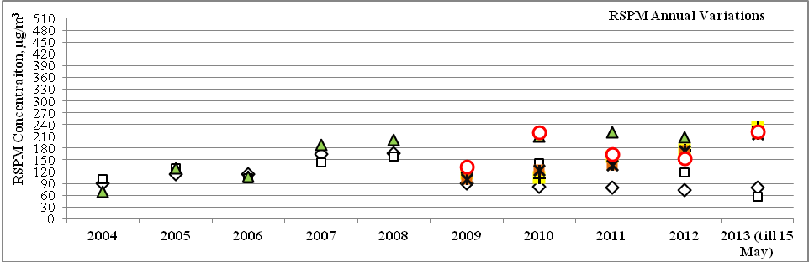
Annual Variation of NOx, SO₂, RSPM and SPM Concentrations at the Six Monitoring Stations in Chandrapur, Averaged Over the period from 2004 to 2013
CPCB Standard Limit

Slide 19
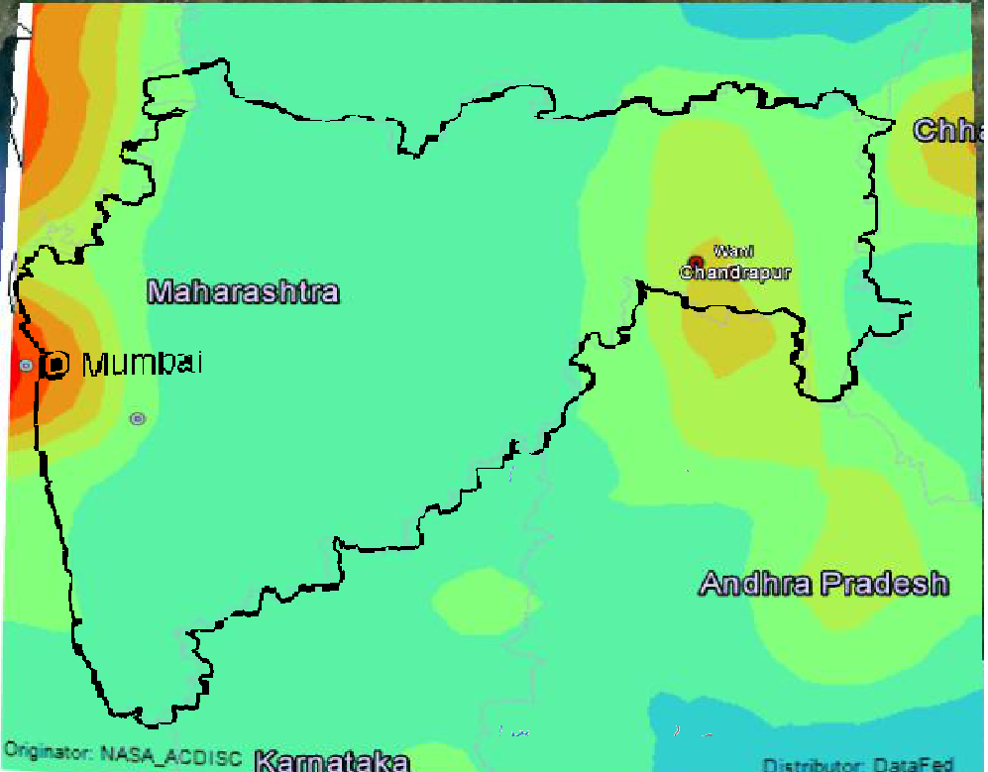
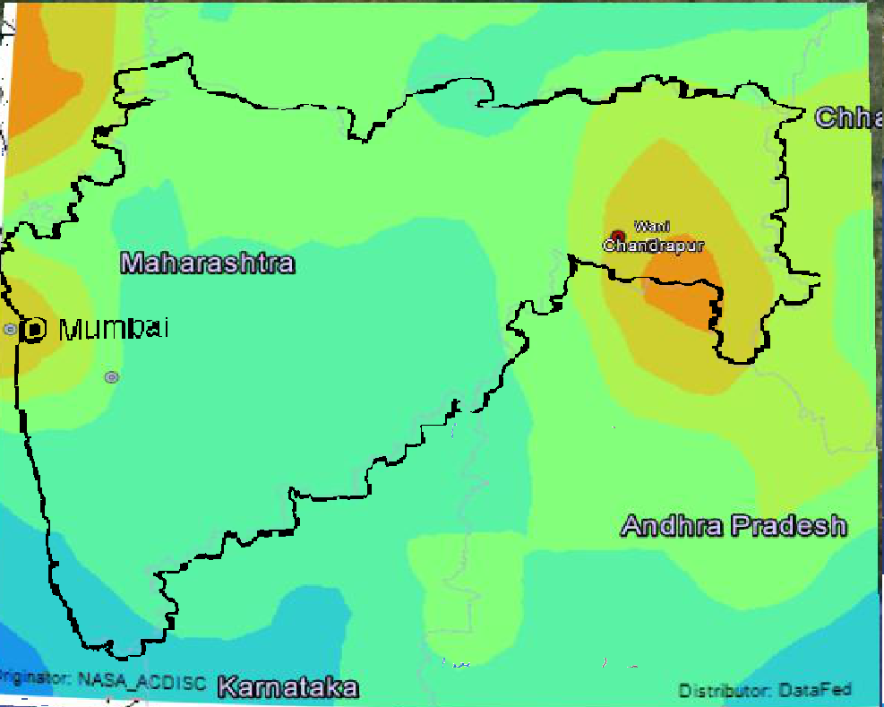
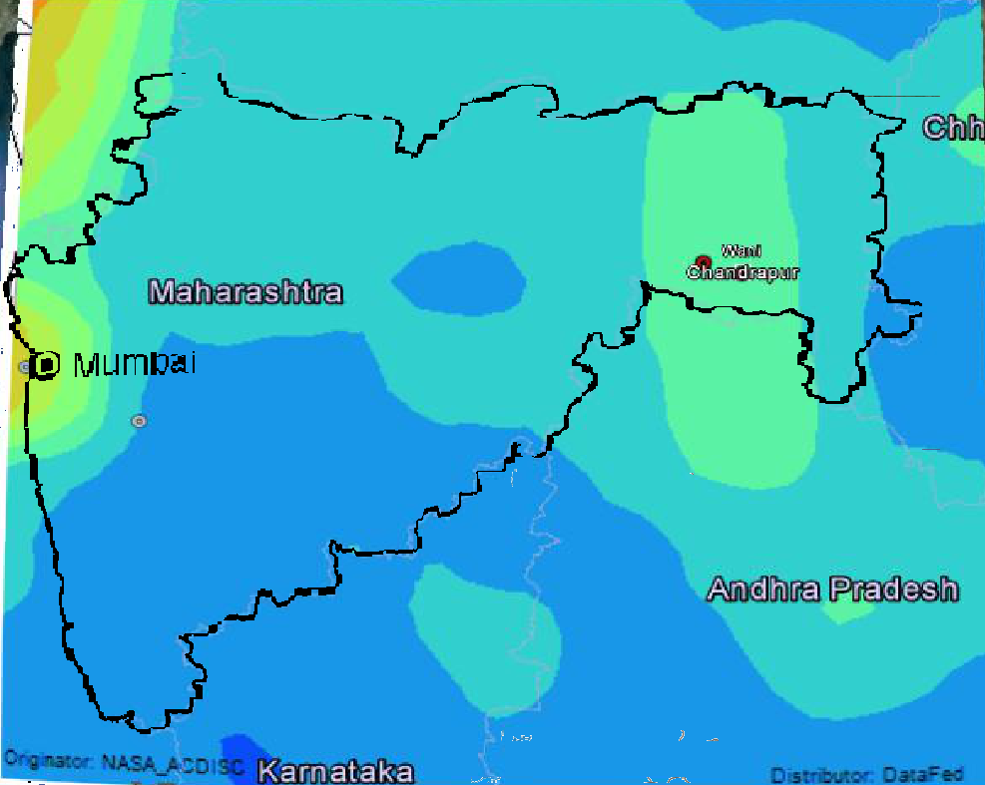
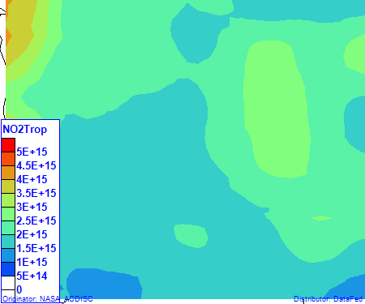
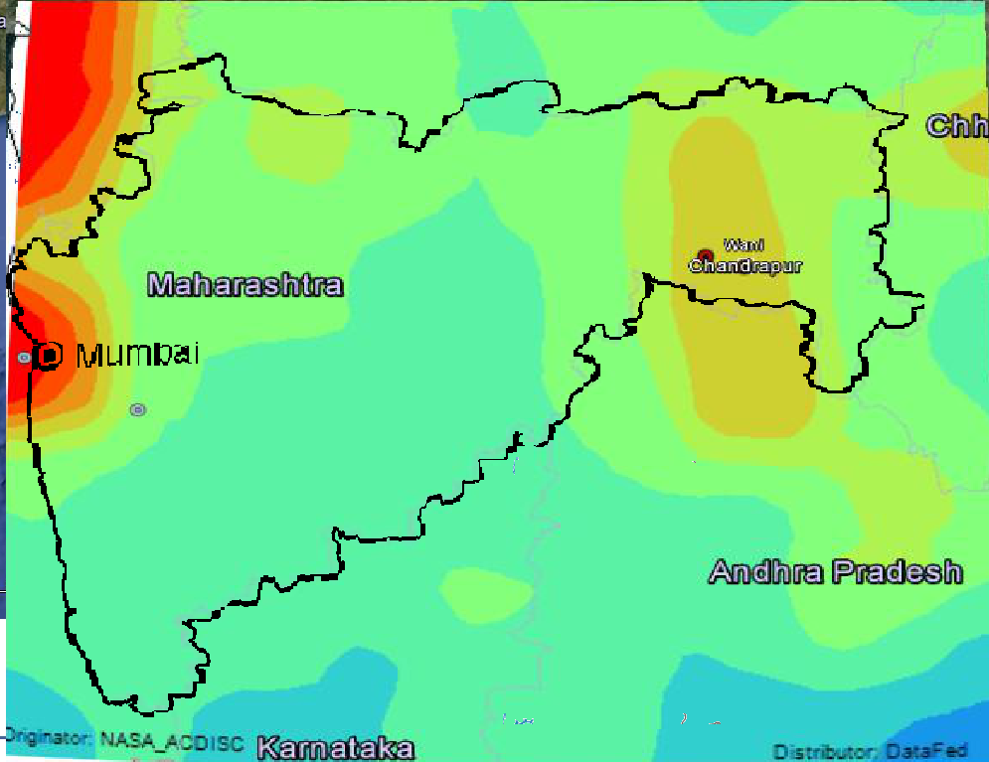
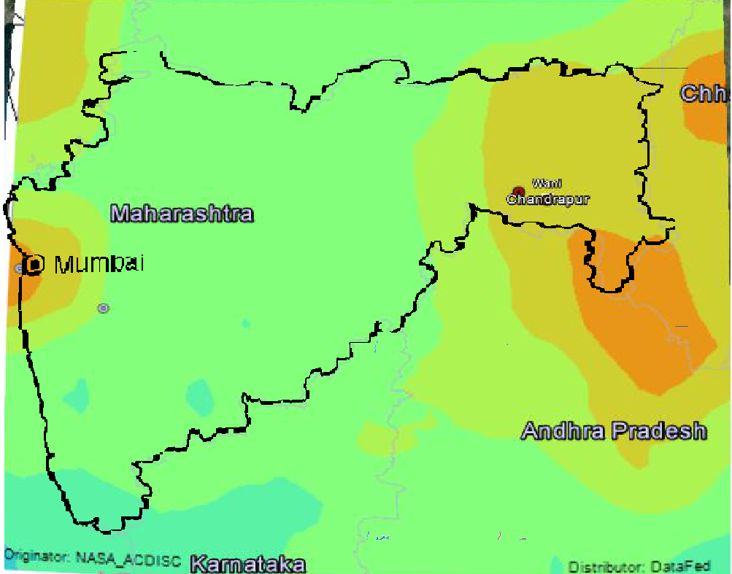
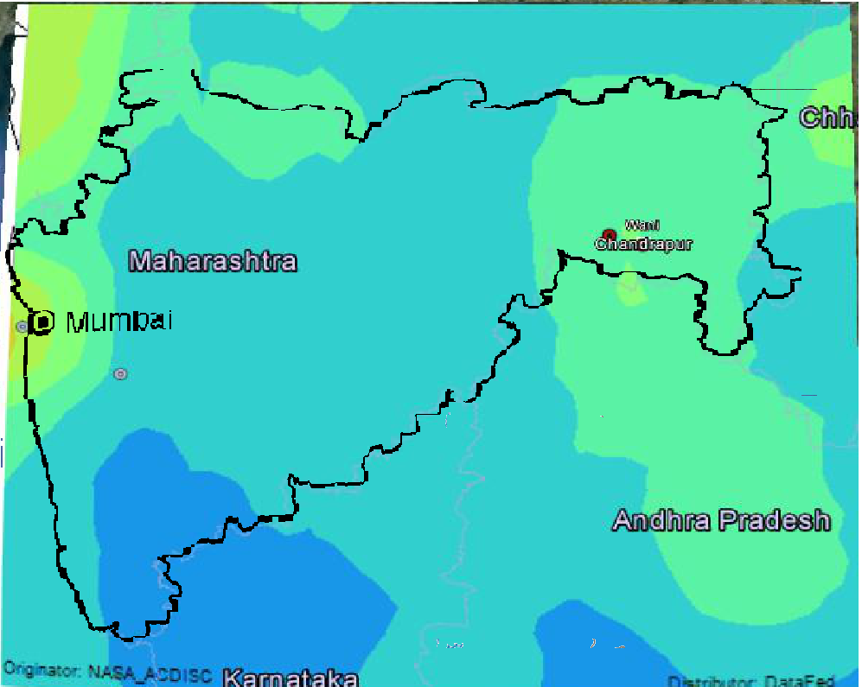
Seasonal Patterns of Columnar NO2 Density over Maharashtra
Dec-Feb
March-May
Sept-Nov
2005-2006
2009-2010
October 4, 2020
CESE, IIT Bombay
19/20

Slide 20
Air Quality Modeling
for
Chandrapur Region

Slide 21
Input Data for Air Quality Modeling
Model : Version 8.8.9 of AERMOD View Lakes Environmental Software
Inventory Data
Point : 115 Chimneys from 30 Industries
Line : 7 Major Roads covering 11 junctions over 9km x 12 km Chandrapur City (NEERI)
Area Sources :
Unorganised Area Sources : Chandrapur City Spread over
9 km x 12 km
Mines : 18 Coal Mines (Area Sources) over Chandrapur District

Slide 22
Input Data for Air Quality Modeling
Continuation…
Meteorological Data
MM5 data of 12km x 12km resolution surface and upper air meteorological
data for Chandrapur region
Receptors
6-NAMP Stations in Chandrapur District
2-CAAQMS stations (operated by MPCB and CSTPS) in Chandrapur City
7-Seasonal Measurement Locations (Using MiniVol) in Chandrapur City
11- point loop locations in Chandrapur District
Terrain Data
USGS-SRTM 30 m resolution DEM terrain data for Chandrapur region

Slide 23
Assessment of Alternative Meteorological Datasets
for
Chandrapur Region
Air Quality Modeling

Slide 24
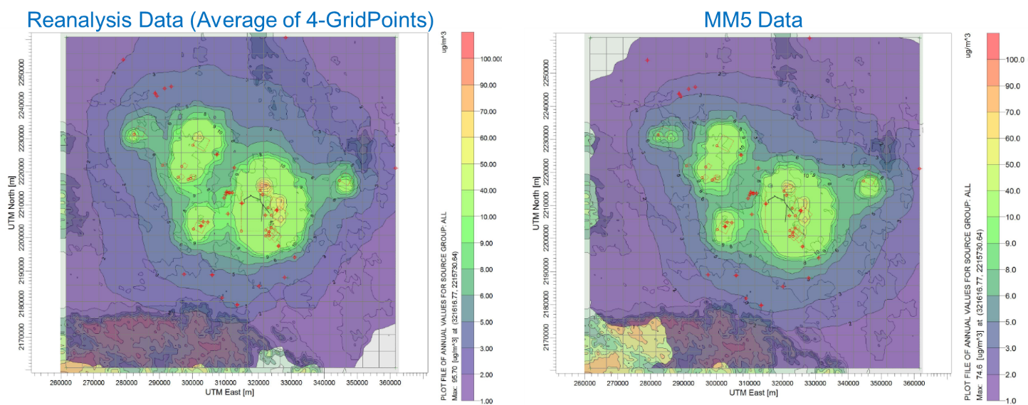
Comparison between outputs of AERMOD annual averaged PM₁₀ concentration isopleths using input of MM5 data and Reanalysis data

Slide 25
Model Results for the PM at the Six NAMP Stations

Slide 26
Map of Emission Sources and AAQ Monitoring Stations in Chandrapur
26

Slide 27
Map of Emission Sources and AAQ Monitoring Stations in Chandrapur
27

Slide 28
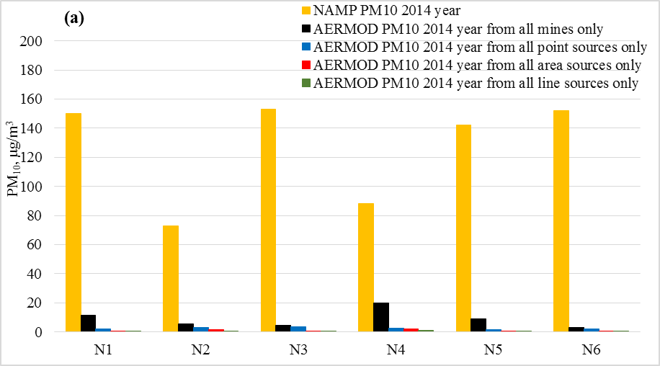
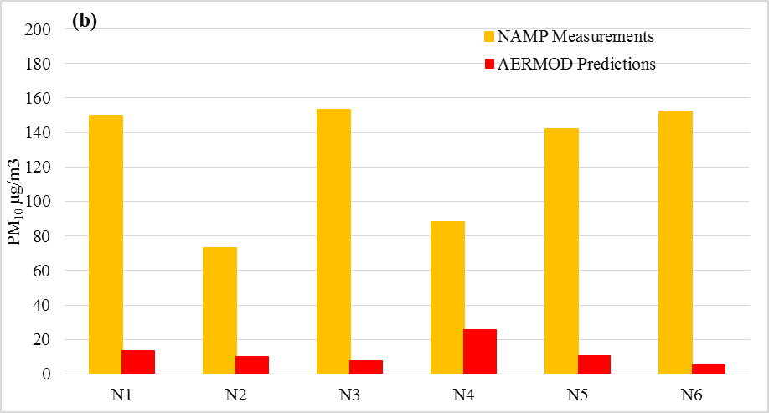
Comparison between PM₁₀ of Annual Average AERMOD Predictions for Point, Mine, Line and Other Area Sources with NAMP Observations for Year 2014

Slide 29
Contribution from Point, Line and Area sources to the PM10 Measured at the 6 NAMP Stations is 2 - 32% in the worst seasonal case scenario and Only point sources contribution is 2-6% in ground level mass concentrations
What are the reasons for
model under-estimations ?
FUGITIVES

Slide 30
Diagnostics
Sources and Measurements
100%
Fugitives - cookstoves, road dust
Errors
Vehicles
Assumed Industrial Sources are doubled
Current Industrial sources

Slide 31
FUGITIVES Use of Episodic Events to do the detective work ☺ 1. Rain versus No-Rains 2. Miners’ strike

Slide 32
Next two slides show the difference between Winter and Monsoon measurements (The fugitive dust is missing during monsoons)

Slide 33
Morning And Evening Hour PM10 And PM2.5 Measurements At 11-point Loop Locations For Winter Season, 2014

Slide 34
Morning and Evening Hour PM10 And PM2.5 Measurements at 11-point Loop Locations for Monsoon Season, 2014

Slide 35
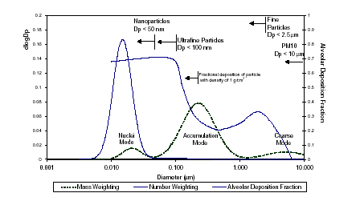
Tri-modal Particle Size Distribution
(Source: Kittelson et al. 1999)

Slide 36
Coarse mode was absent when it rained (Next slide)

Slide 37
Spatial Variations in Particle Mass Size Distributions Over Chandrapur Region
This Mode is absent when it rained

Slide 38
Effect of Rainfall on PM_{2.5} and PM₁₀ – 2016 - Pune
Black Line indicates 24 hr NAAQS (100µg/m³) for PM₁₀ and Red line indicates 24hr NAAQS (60 µg/m³) for PM_{2.5}

Slide 39
Effect of Rainfall on PM (2-year CAAQMS data) - Navi Mumbai
Black Line indicates 24hr NAAQS (100µg/m³) and Red line indicates annual NAAQS (60µg/m³) for PM₁₀

Slide 40
Miners’ Strike as an Episodic Event

Slide 41
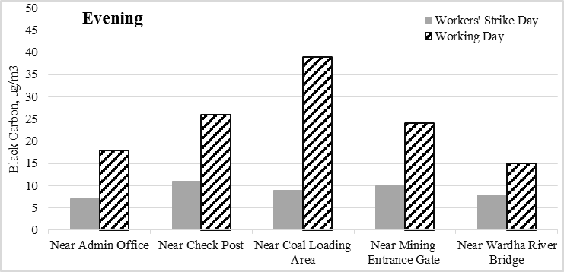
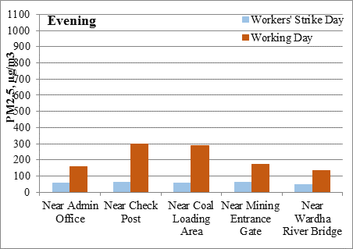
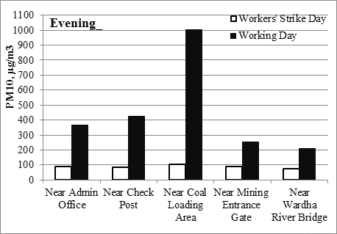
Comparison between PM₁₀ and PM_{2.5}, and Black Carbon (BC) Levels on the Day of Workers’ Strike with Levels on a Subsequent Day When Mining Operations Resumed

Slide 42
Case Study - Chandrapur
Monsoon time – was a good time to isolate the combustion sources from the “dust” emissions
Address domestic coal burning (key source of air pollution that is not accounted for) :
Better Coal “Chulha” ? Better fuel ?
Free electricity ?
Improved Road Design to prevent dust from gathering on the roads and prevent resuspension

Slide 43
Please see 20 Questions ppt for Exam related questions

Slide 44

Thank you for your Committed Engagement in the Classes

